Slide 1
Transportation Funding Jerry Lassiter Financial Administrator Alabama State Department of Education Office of Supporting Programs Pupil Transportation Section

Slide 3
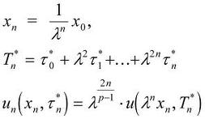
New Transportation Funding Formula

Slide 4
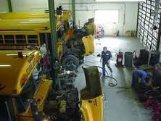
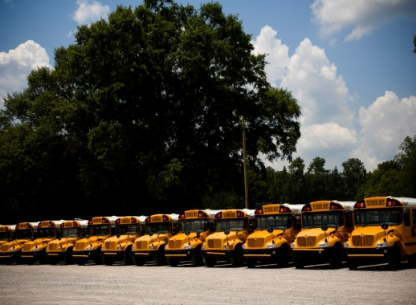
Allocation Components
Operations
Fleet Renewal

Slide 5
Operations
Qualifying Buses
Salaried Positions
Coding
Benefits
Fuel
Operational Costs

Slide 6
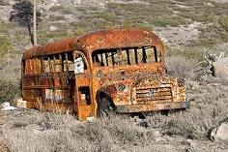
Qualifying Buses
Morning and Afternoon Route Buses
Midday Route Buses
20% Spare Allowance
- Lift Equipped Buses
- Non-Lift Equipped Buses

Slide 7
SALARIED POSITIONS
Positions earned based on size of operation
# of Bus Drivers based on efficient routing
Salary amounts from LEAPS
Amounts determined by individual system salary schedule
Maximum salary applied
Minimums for unfilled positions
% of positions earned for small operations
Function and object code usage will be limited
Flexibility with positions
Applies to Contract Systems

Slide 8
Positions Funded w / Salaries
FY 2024
* Proportional allocation for systems earning less than one position.
Required Position, non-flexible.
POSITION | RATIO | ADDITIONAL | MINIMUM | MAXIMUM
Supervisor | 1/40* | No additional | $63,121 | $105,025
Secretary | 1/40* | Second@100; additional every 100 | $32,700 | $49,460
Assistant Supervisor | 1/200 | Additional every 200 | $80,233 | $101,728
Mechanic | 1/22* | 1@22, 2@33; additional every 22 | $39,544 | $55,789
Shop Foreman | 1/55 | 1@55; additional every 88 | $49,134 | $69,029
Parts Specialist | 1/100 | Additional every 250 | $35,895 | $51,400
Shop Assistant | 1/22* | 1@22, 2@33, 3@55, 4@77, additional every 88 | $26,391 | $41,812
Route Specialist | 1/75 | Additional every 100 | $45,308 | $75,701
Bus Driver | 1/1 | N/A (Midday: $50.00 X 180 days X # of buses) | $14,654 | $19,285
Utility Worker | 1/40* | Additional every 40 | $13,743 | $17,860
Bus Aide | IEP | Not Funded | $0 | $0
Nurse | IEP | Not Funded | $0 | $0
Notes:
1 FOR 22 MECHANIC RATIO & 150 SHOP FOREMAN RULE

Slide 9
Coding

Slide 10
Route Report LEAPS Crosswalk
ROUTE TYPE ABBREVIATION FUNCTION CODE FUNDED (Y/N)
Regular Route RR 4120 Y
Regular Route with Aide RA 4120 Y (Aides-No)
Natural Disaster ND 4121 Y
Special Needs SN 4130 Y
Special Needs with Aide SA 4130 Y (Aides-No)
Transition to Work TW 4131 N
Transition to Work with Aide TA 4131 N (Aides-No)
Special Needs Midday SM 4132 Y
Special Needs Midday with Aide MA 4132 Y (Aides-No)
Technical School TS 4140 Y
Midday MD 4141 Y
Choice Transportation/AAA CT 4180 Y
Head Start HS 4181 N
Preschool Home PH 4182 N (Aides-No)
Alternative School AS 4183 Y
Magnet School MS 4184 Y
Magnet Home MH 4185 N
Preschool PS 4186 Y (Aides-No)
Alternative Home AH 4187 N
Extended Day/Summer School ED 4188 N
Homeless Transportation HT 4189 N
Function Code/Object Code Table for Transportation Funding
The table below will detail out the edit checks. The object code(s) listed under each function code are the only ones allowed.
Incorrect coding can result in a loss of transportation funding.
Function Codes | 4110 | 4120 | 4121 | 4130 | 4131 | 4132 | 4140 | 4141 | 4170 | 4180 | 4181 | 4182 | 4183 | 4184 | 4185 | 4186 | 4187 | 4188 | 4189
Object Codes | 054 | 103 | 161 | 103 | 103 | 103 | 161 | 161 | 115 | 161 | 103 | 103 | 161 | 161 | 161 | 103 | 161 | 161 | 161
 | 099 | 121 | 167 | 121 | 121 | 121 | 167 | 167 | 151 | 167 | 121 | 121 | 167 | 167 | 167 | 121 | 167 | 167 | 167
 | 113 | 131 |  | 131 | 131 | 131 |  |  | 158 |  | 131 | 131 |  |  |  | 131
 | 117 | 161 |  | 161 | 161 | 161 |  |  | 159 |  | 161 | 161 |  |  |  | 161
 | 139 | 167 |  | 167 | 167 | 167 |  |  | 168 |  | 167 | 167 |  |  |  | 167
 | 141 | 168 |  | 168 | 168 | 168 |  |  | 173 |  | 168 | 168 |  |  |  | 168
 | 168 | 169

Slide 11
Benefits
Social Security – 6.2% Medicare – 1.45% Retirement – 12.59% & 11.57% U. C. – .125%
PEEHIP ($800 X 12 mo. X Positions Earned)
Leave – 7 Days Per Position Earned @ $50 / Day

Slide 12
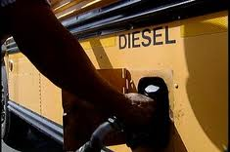
Fuel
Route Report Mileage
Route Report MPG
Projected Cost of Fuel (AAA)

Slide 13
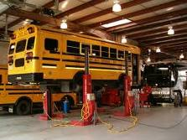
Operational Costs
Amount per bus will be calculated
Multiplied by number of qualifying buses

Slide 14
Fleet Renewal
Number of Qualifying Buses (Route Report)
Ten years or less in age
Qualifying Route Types
Invoice Date & On Order Buses
Amount Earned Per Qualifying Bus
Based on average price of a bus divided by 10
Bus Financing Must Be State Approved
for Systems Lacking a 1-Month Operating Balance

Slide 15
Issues
Extracurricular
Out
Rate: $1.85
Retired Personnel & Teachers
Summer Food Service Program
AAA

Slide 16
OPERATIONS ALLOCATION
80.5%
FY 2023
82.6%
FY 2024
FUEL
FY 2023 $3.81
FY 2024 $5.10
Current Price $3.14
Contractor Price $3.68

Slide 17
FLEET RENEWAL ALLOCATION
FY 2023 – ETF
$7,581 PER BUS
6,563
QUALIFYING BUSES
FY 2024 – ETF
$7,581 PER BUS
QUALIFYING BUSES 6,803

Slide 18
NEW LEGISLATION
Supplemental Bill
$20 Million for Fleet Renewal
2% Pay Raise
$15 Per Hour for All Positions
Bid Law Changes

Slide 19
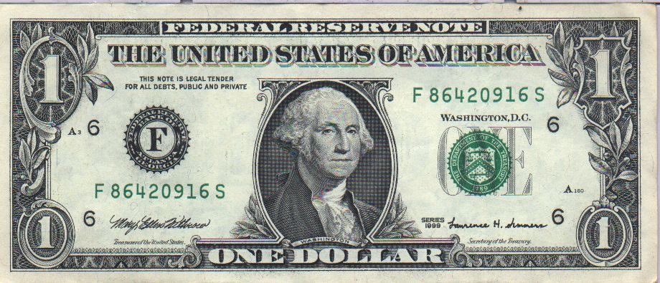
Questions?

